Slide 1
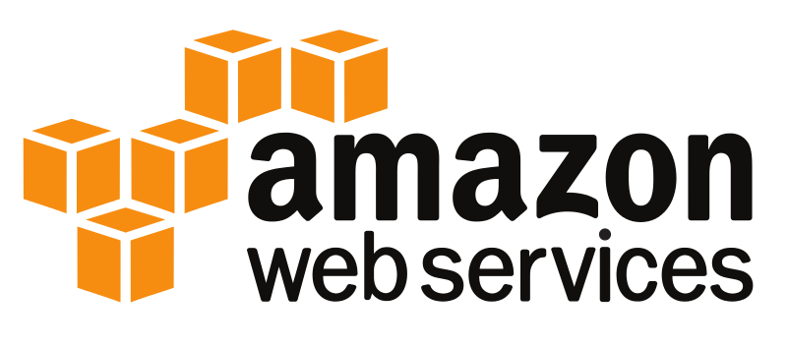
Introduction to AWS Global Infrastructure

Slide 2
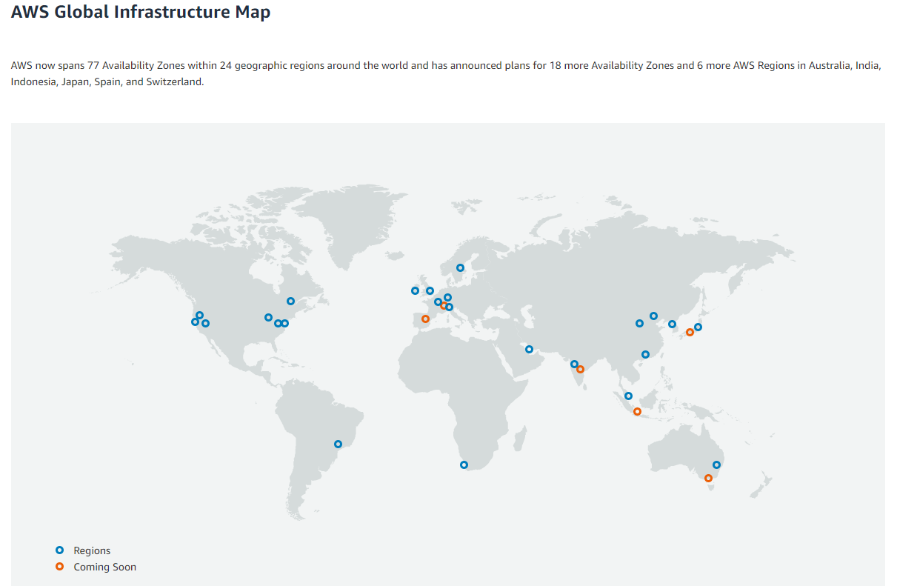
Global Infrastructure
https://aws.amazon.com/about-aws/global-infrastructure/

Slide 3
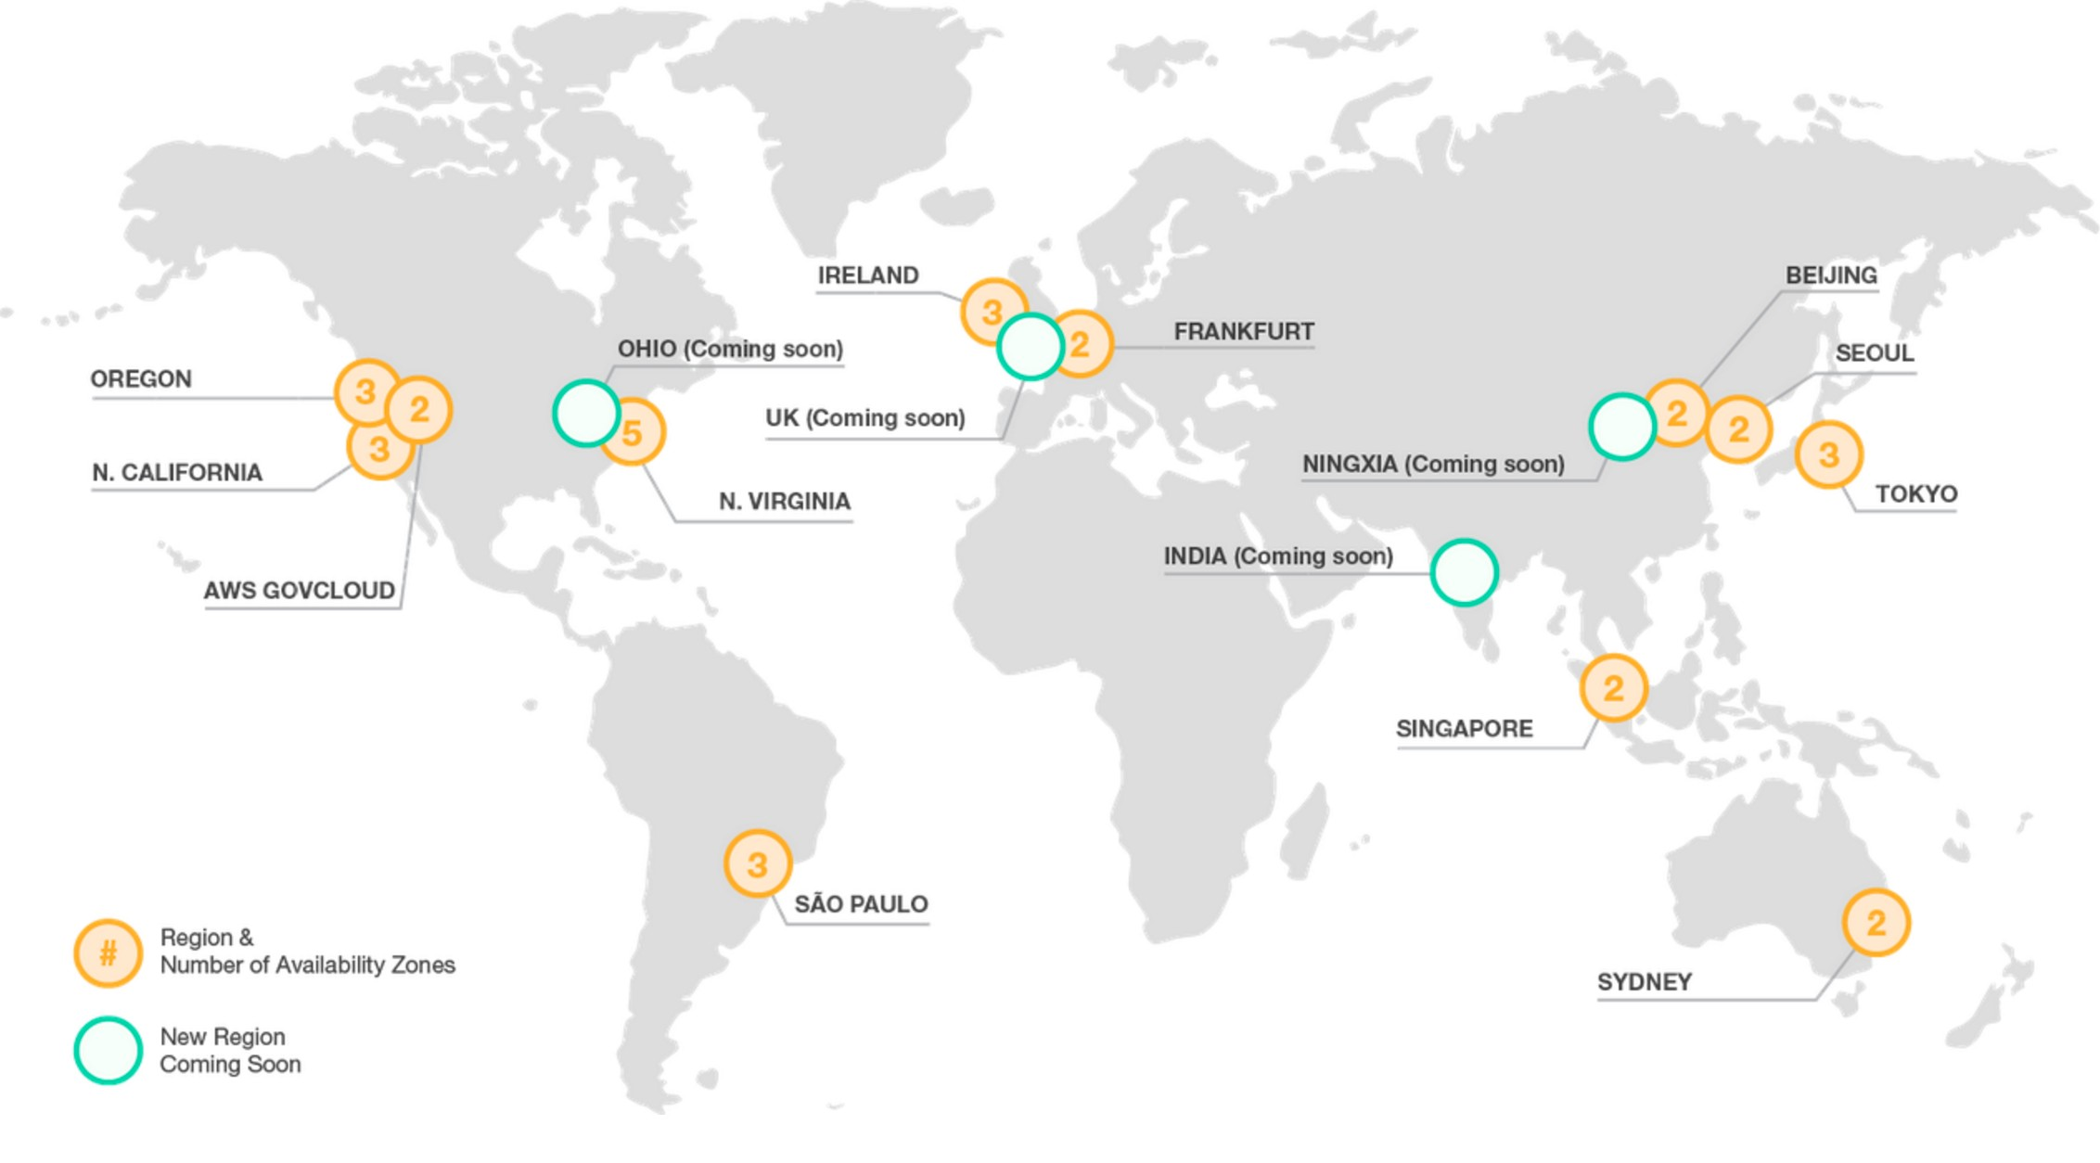
Global Infrastructure
https://aws.amazon.com/about-aws/global-infrastructure/

Slide 4
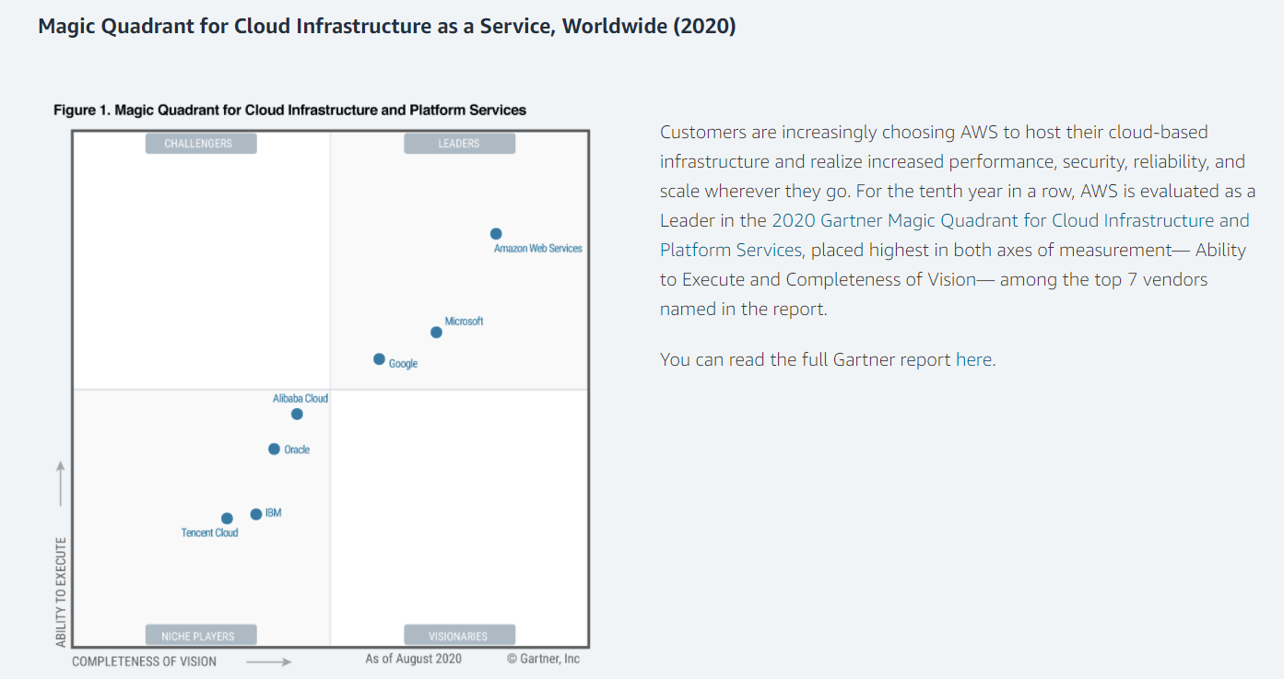
Global Infrastructure
https://aws.amazon.com/about-aws/global-infrastructure/

Slide 5
Magic Quadrant
https://aws.amazon.com/about-aws/global-infrastructure/

Slide 6
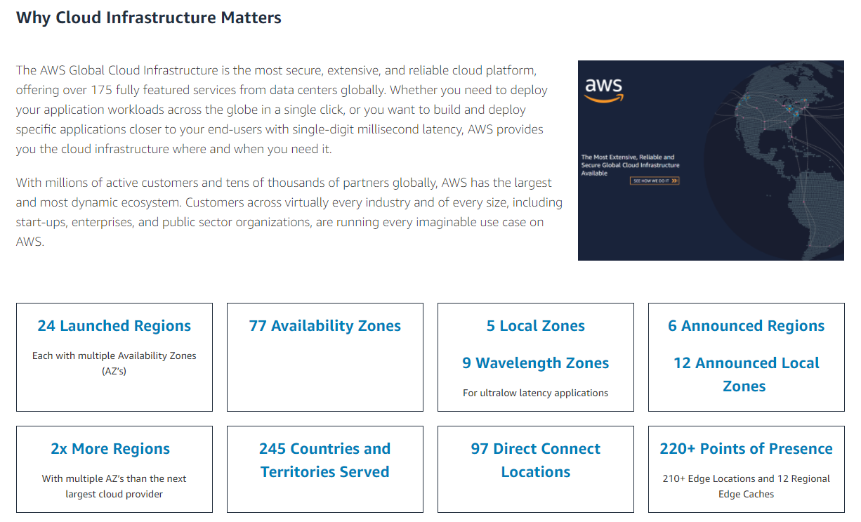
Global Infrastructure

Slide 7
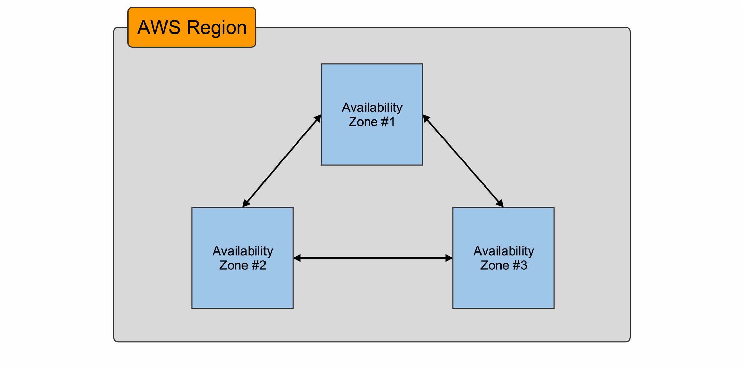
AWS Region
Region is a geographical area.
That is a collection of AWS availability zones and data centers.

Slide 8
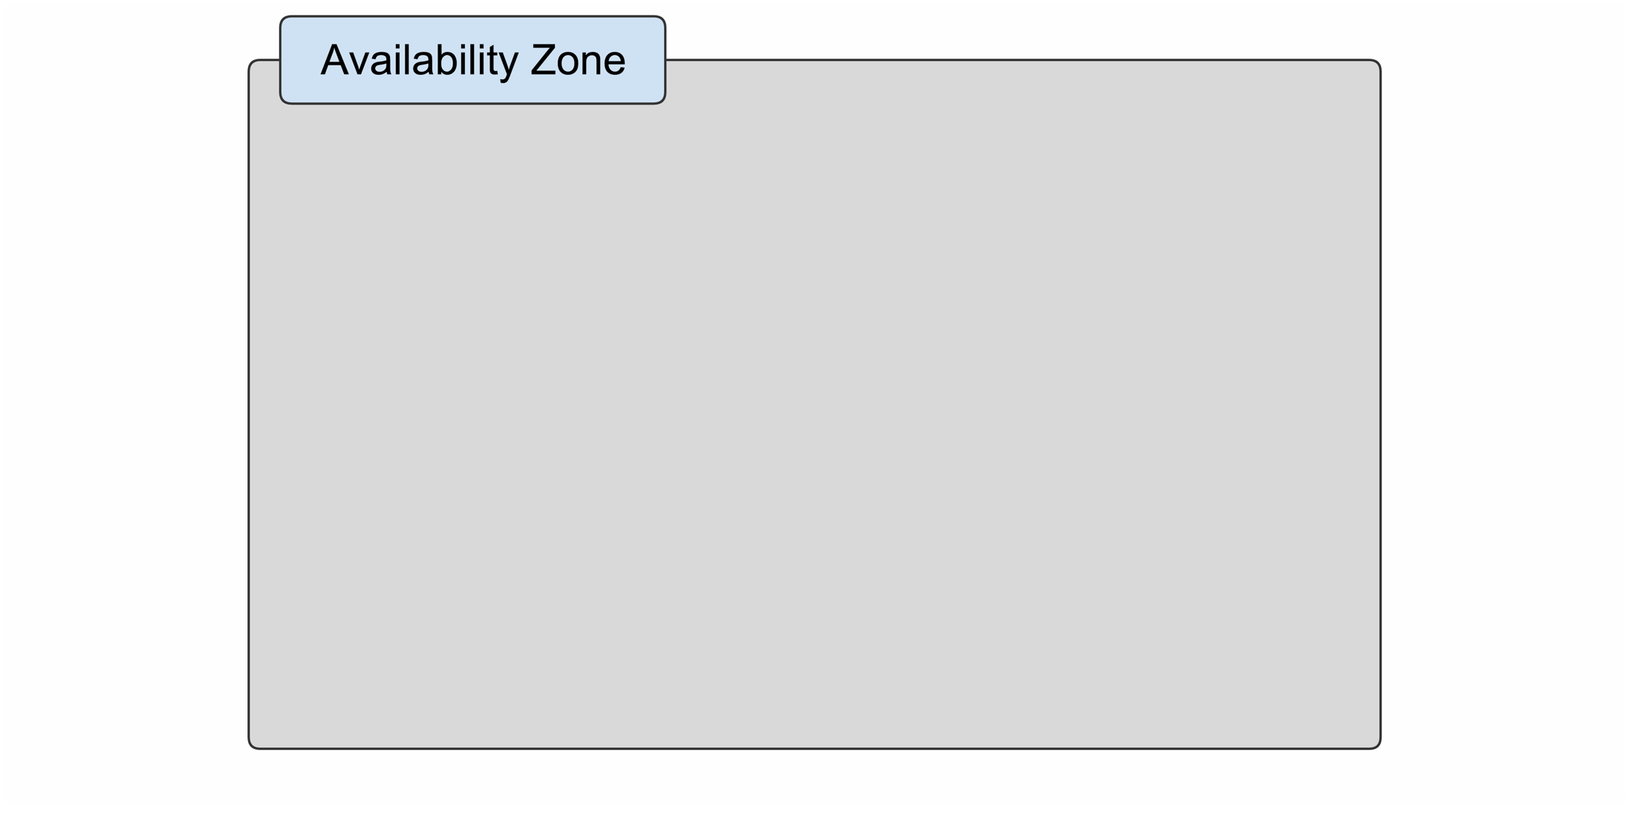
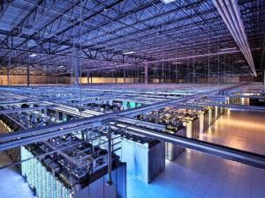
AWS AZ
Availability zone is actually a geographical physical location that holds in AWS data center.
We've zoomed into an availability zone and there was where we see the physical hardware the physical
data center where all of the AWS resources and any data or information that you put on AWS is located.
Data Center:

Slide 9
Conclusion
We have our regions within our regions we have availability zones and there are multiple availabilities zones for redundancy.
Inside each availability zone our data centers the physical hardware
Physical pieces of hardware that you create and provision your AWS resources or utilize something like an S3 bucket.
So when you create an AWS account and you go to create a bucket or to launch an Amazon EC2 Instance
You're always choosing what region and what availability zone you want those things take place.

